Slide 1
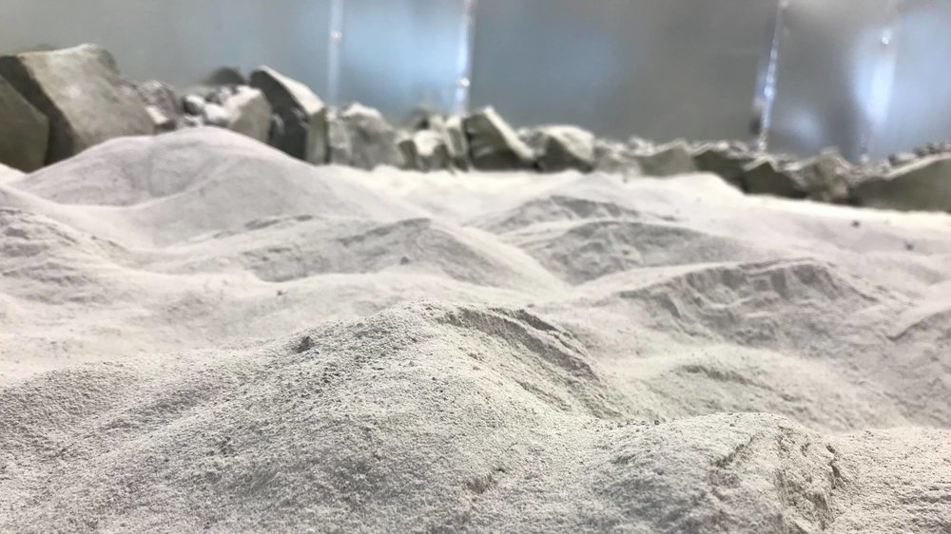
Off Planet Research
Simulants, Consulting, Testing, and
Technology Development
NASA and NSF SBIRs:
Icy Regolith Simulants
Dust Tolerant Flexible Seals
Removable Protective Cover
Dust Tolerant Connectors
Speaking Today: Melissa Roth
Off Planet Research, LLC 2023

Slide 2
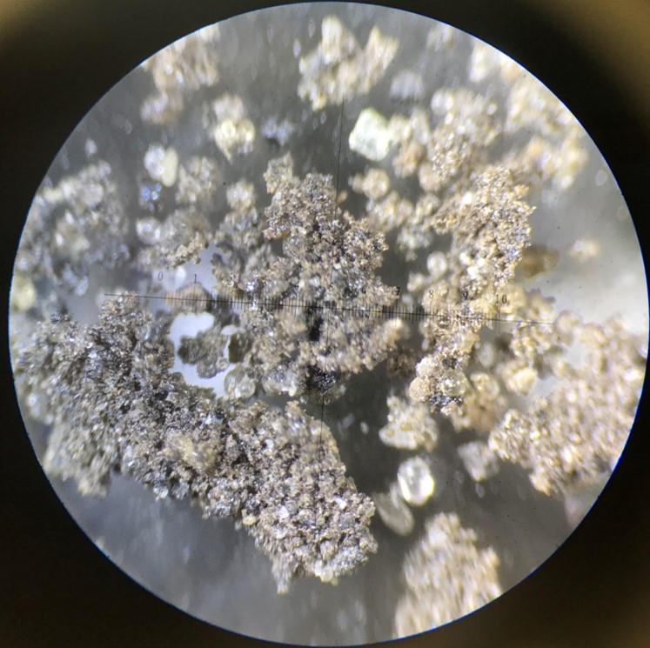
OPR Simulants
General Simulants:
OPRH2N Near Highland simulant (anorthosite-rich)
OPRH3N Far Highland simulant (anorthosite-rich)
OPRH4N PAN Highland simulant (anorthosite-rich)
OPRL2N Mare simulant (basalt-rich)
Specialized Simulants:
Simulants with Increased Magnetic Response
OPRL2NT Mare simulant (basalt-rich) higher titanium
Simulants with increased magnetic response
OPRFLCROSS2 Lunar Ice simulant
We also provide custom simulants and agglutinates. Our custom simulants can be as simple as adding an additive (ie. ilmenite or glass), replicating an Apollo sample, or creating a new and unique simulant specific to the type of testing the client is conducting. We can alter the particle size distribution or mineral composition to fit the requirements of the testing.
Off Planet Research, LLC
Off Planet Research, LLC 2023

Slide 3
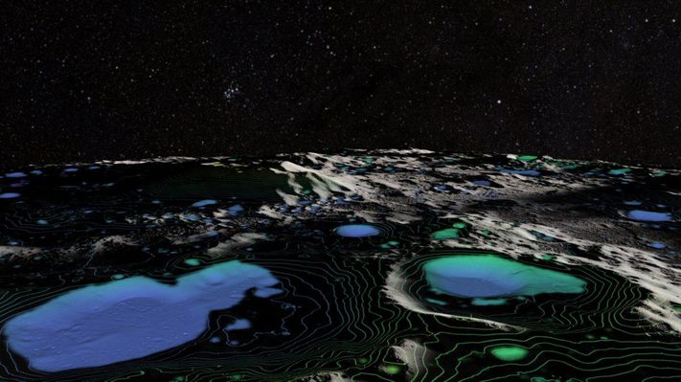
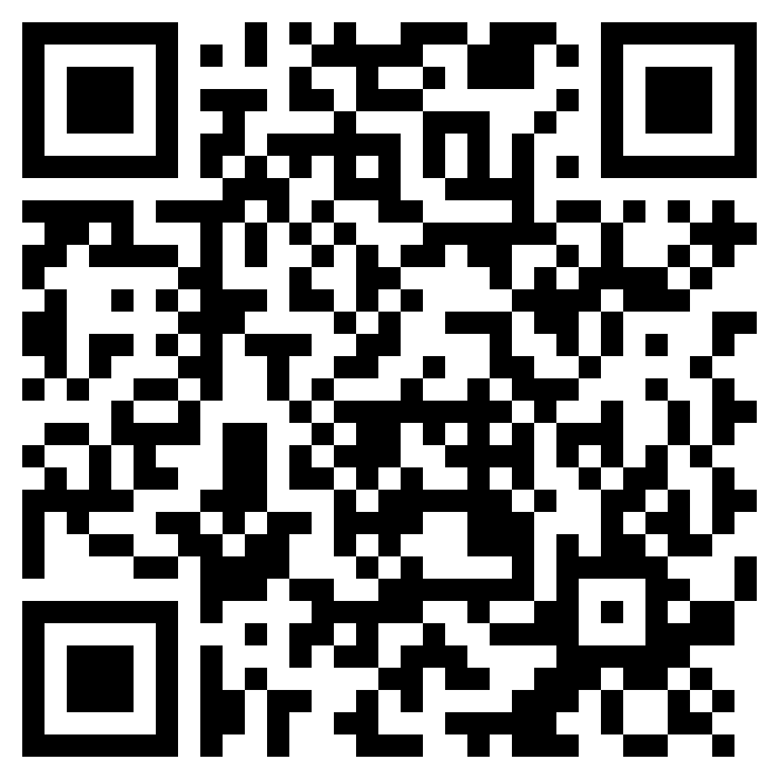
Regolith/Surface Interface Subgroup
RSI Homepage
https://lsic-wiki.jhuapl.edu/pages/viewpage.action?pageId=1672135
Monthly Meetings: 4th Tuesday of every month, 1 p.m. ET
Email: melissa@offplanetresearch.com

Slide 4
Crosstalk: Regolith/Surface Interface and Vacuum/Exosphere Environment
Part 1
Tuesday, September 26th at 1pm ET
Troubleshooting Vacuum Chamber Problems
Marco Garcia, Honeybee Robotics
Regolith and Simulant in a Vacuum at High Temperatures
Dr. Karl Hibbitts, JHUAPL
Part 2
Thursday, October 26th at 12pm ET
General Vacuum Interactions with Regolith and Simulant
Dr. Michael Poston, Southwest Research Institute
Volatile Interactions in a Vacuum
Dr. Lauren Mc Keown, NASA JPL

